Slide 1
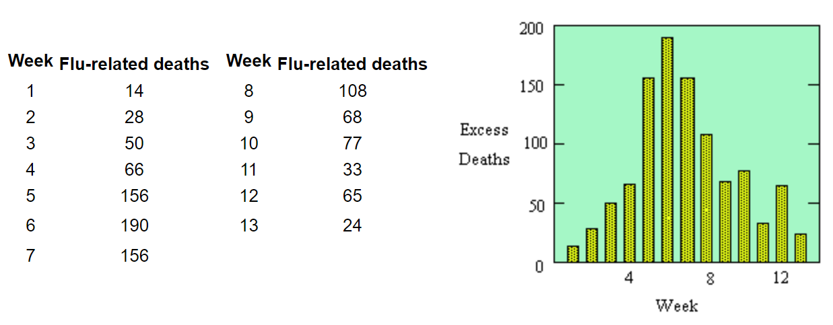
Hong Kong Flu (US, winter 1969-69)
virulent new strain of influenza, named Hong Kong flu for its place of discovery
New York 7.9M : CDC
new cases ∝ deaths 3 weeks ago

Slide 2
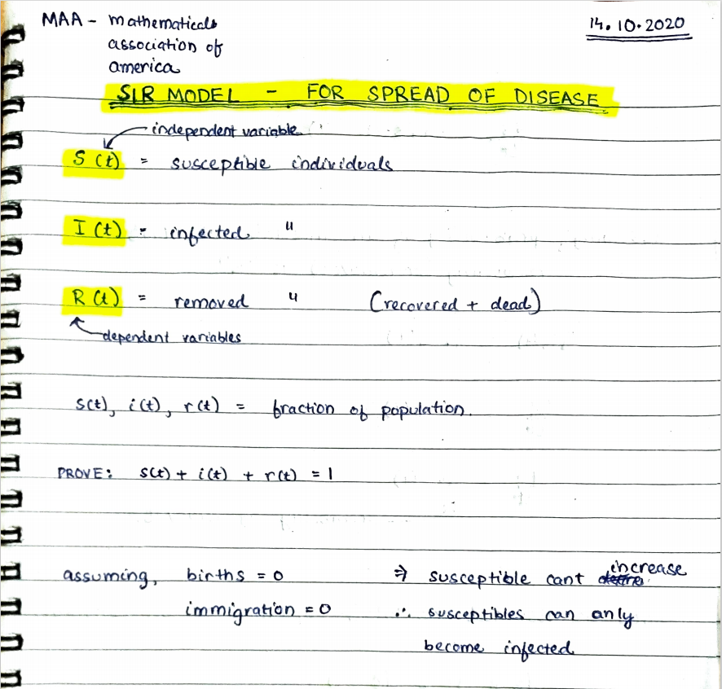
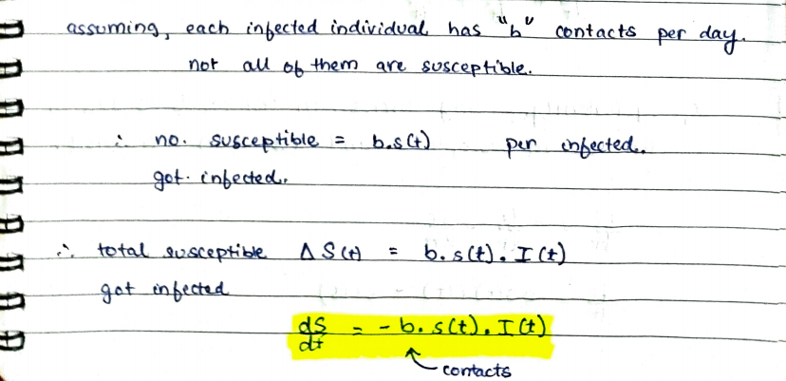
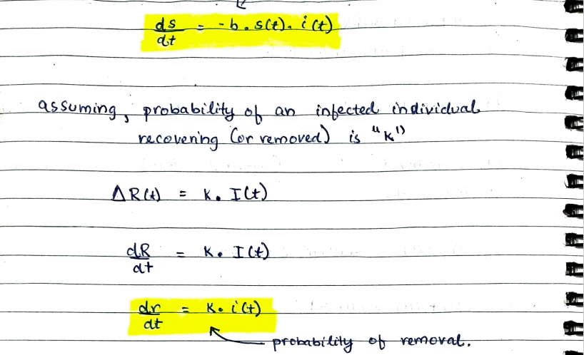

active cases
total – active cases
∴ s(t) is decreasing

Slide 3
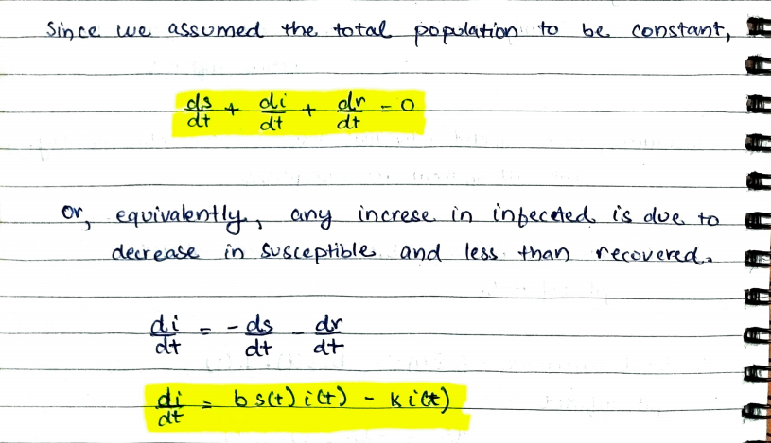
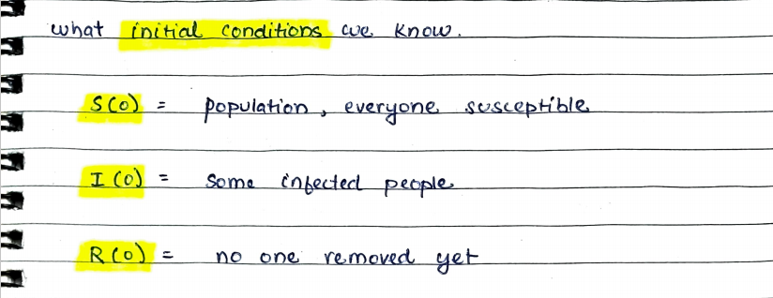
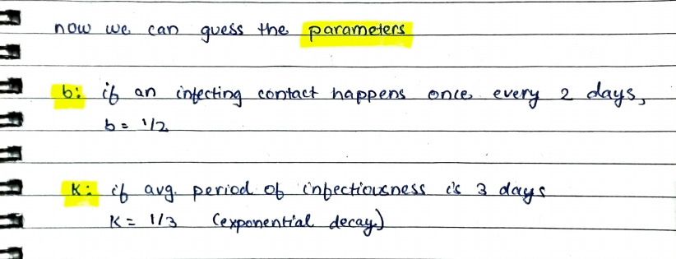
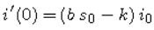
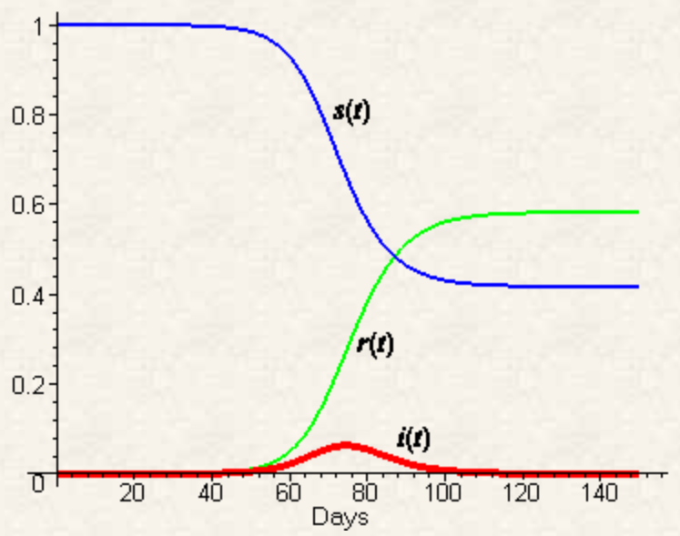
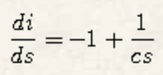
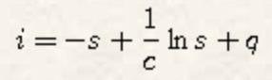
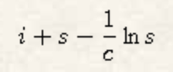
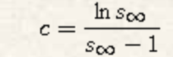
S(0) | 7,900,000
I(0) | 10
R(0) | 0
epidemic can't develop if:
- i'(t) < 0
- s(0) < 1/c
independent of time
D
on integration
R0
s(0) = 1
i(0) = 0
i(∞) = 0
contact number /infected
c = b.D
= b/k
basic reproductive number
R0 = b.D
effective reproductive number
R = b.D.s(t)
1.4-1.6: 2009 flu H1N1, swine
1.4-2.8: 1918 flu H1N1, influenza
12.8: 1918-28 measles (US)
4.9: 1955 poliomyelitis (US)
5.7: COVID-19
For halting epidemic, R ≤ 1
R = R0.s(t)
∴ s(t) = 1/R0
= 0.175
82.5% herd immunity needed
is constant
obtaining parameter
90% vaccine efficacy?

Slide 4
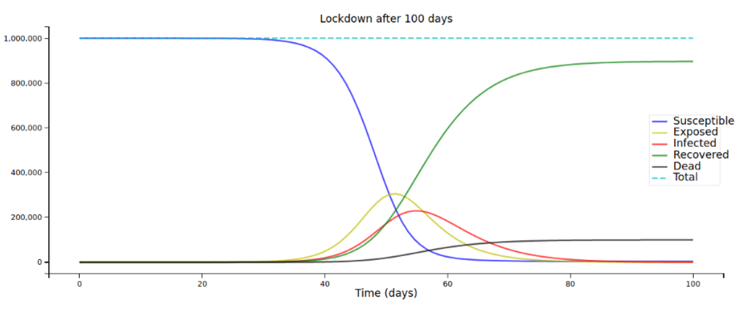
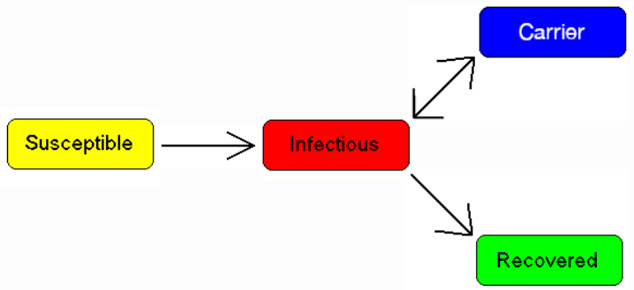
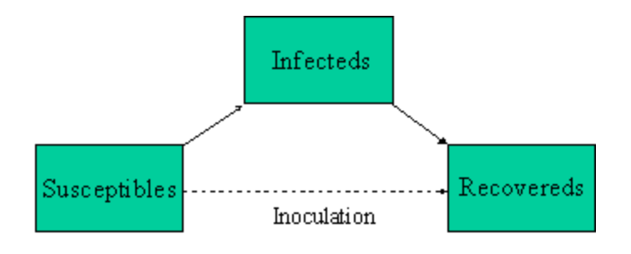
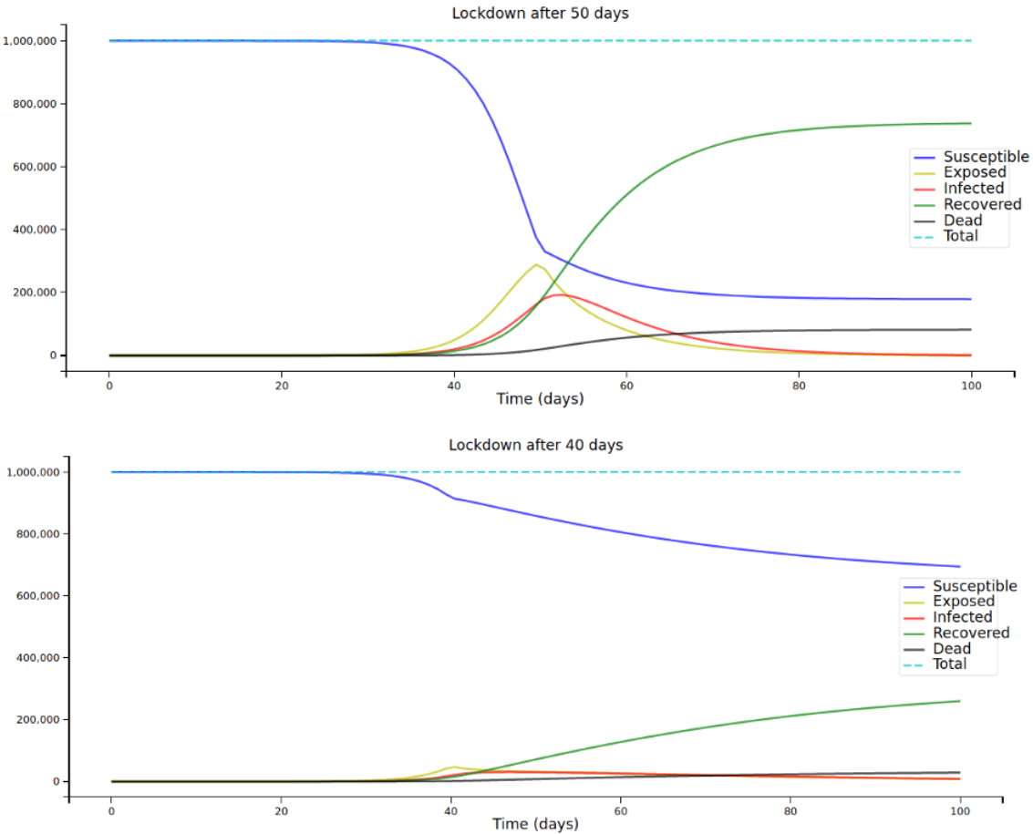
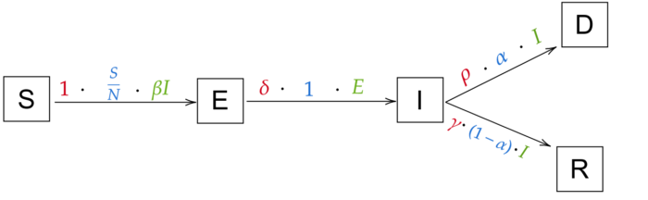

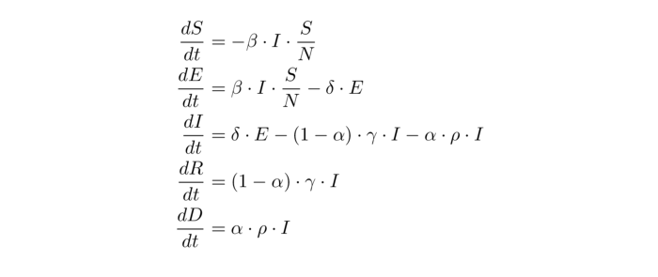
Time-Dependent R₀
measles: babies are immune due to maternal antibodies
COVID-19: disease has significant incubation period
tuberculosis, typhoid: people continue to carry infection without having disease
immunization: for avoiding epidemic
common cold, influenza: no long-lasting immunity
some people die of disease complications
recovered people don't acquire immunity
diseases with passive immunity and latency
recovered people acquire temporary immunity
resource and age dependent recovery and fatality rates
- no. of ICU beds, ventilators available
- high risk groups, like elderly, diabetics
- change in population structure due to fatality

Slide 5
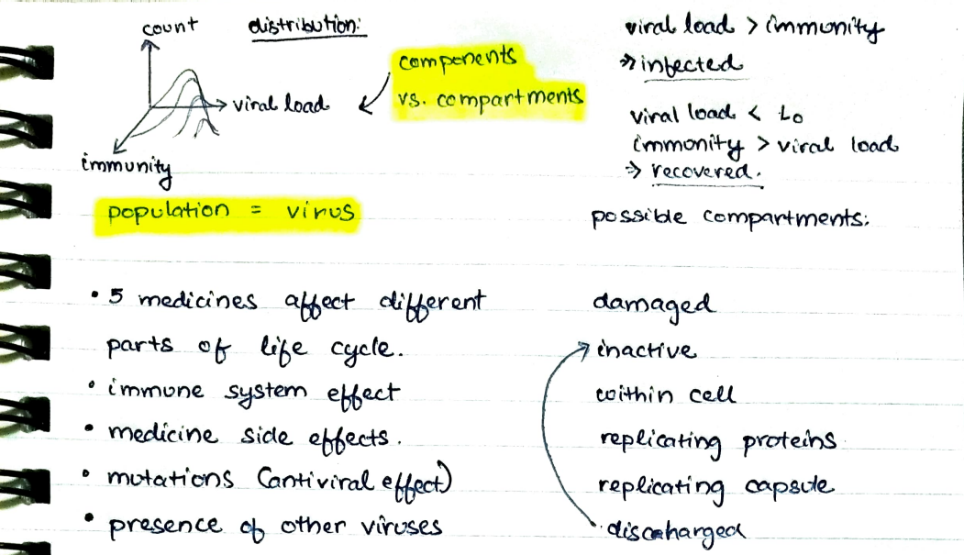
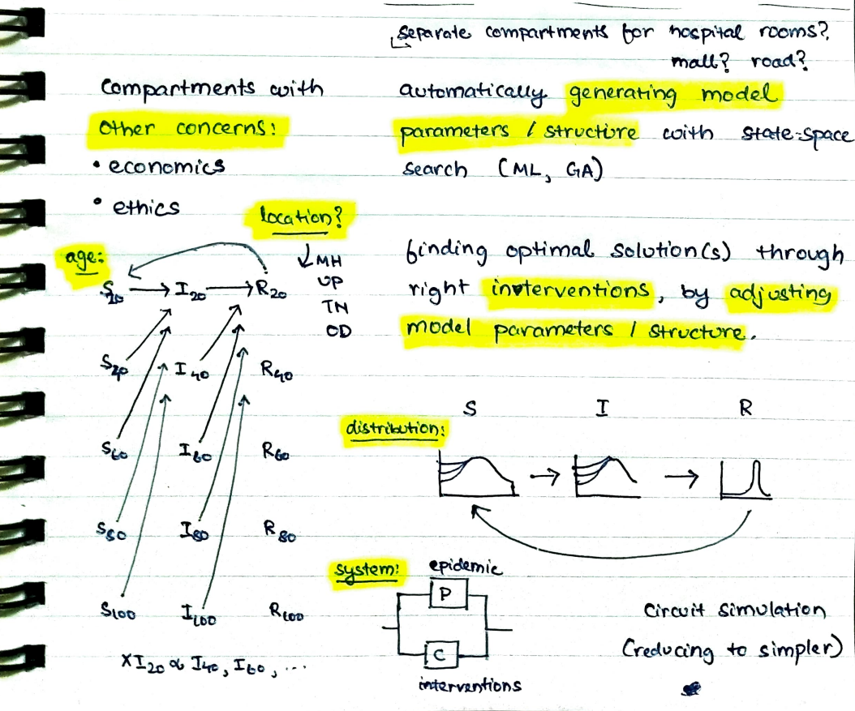


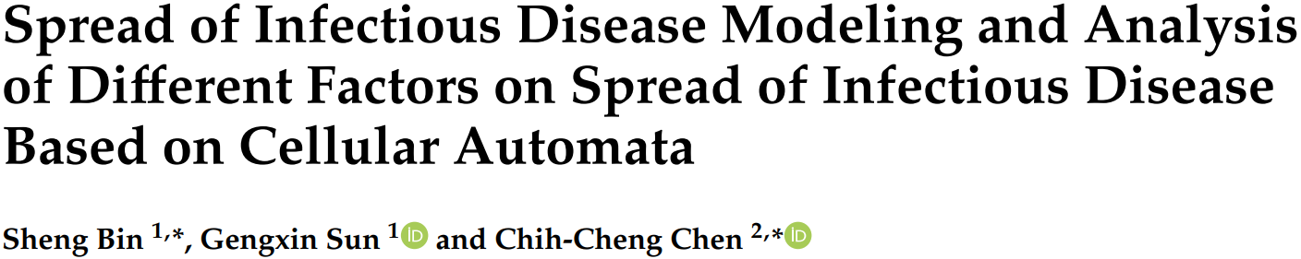
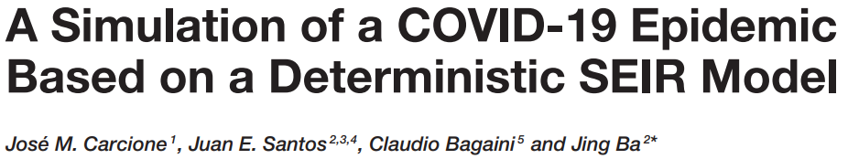

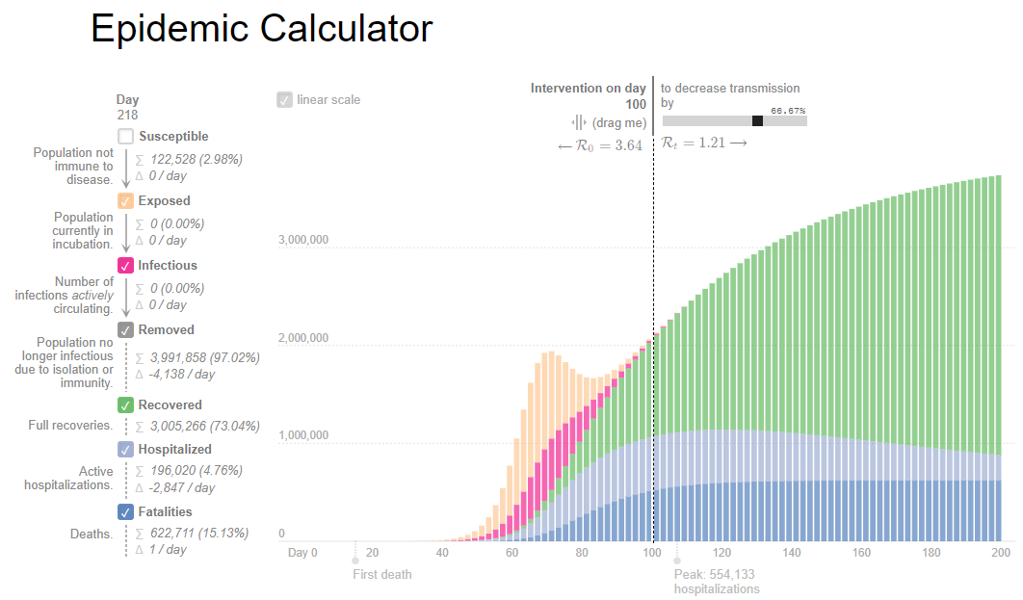
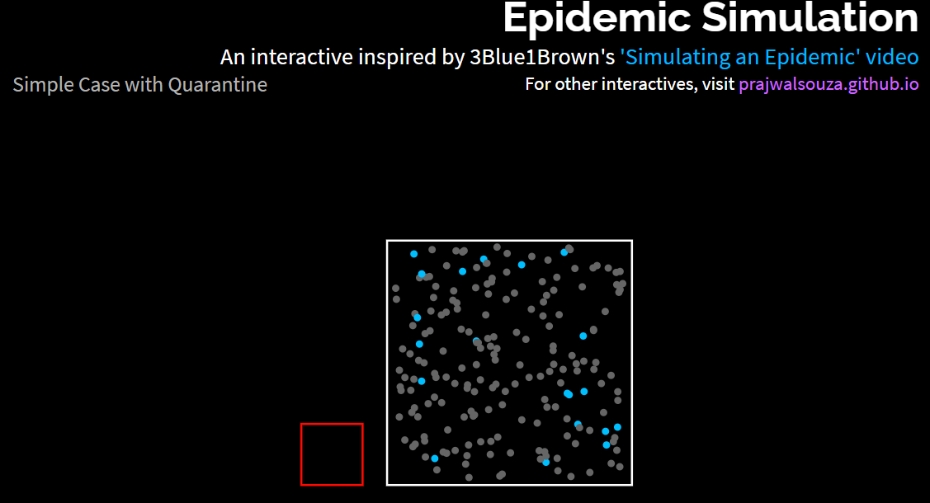

multiple particles
S, I, R, a, x, y
CAS: computer algebra system
function dependent on n variables
s(a, t), i(a, t), r(a, t)
b(a, t), k(a, t)?
levels of parallelism
- multiple parameters values (sir)
- separate graph nodes
- per-node distribution
- multiple time steps

